Slide 1
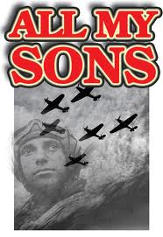
All My Sons
Arthur Miller

Slide 2
Arthur Miller
Born in 1915 in NYC
Father lost his business in Brooklyn during the Great Depression
This affected the Millers tremendously
The majority of Miller’s plays revolve around this idea
Writes with “conscience, clarity, and compassion.”

Slide 3
The Big Question
Should a person make
big decisions without
thinking of the
consequences?

Slide 4
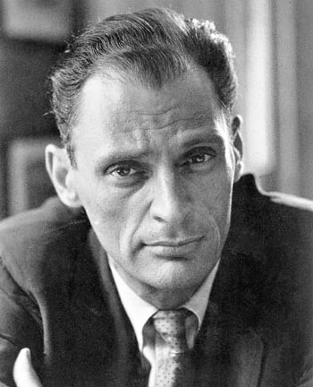
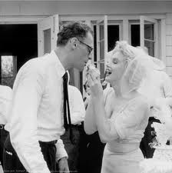
Arthur Miller
“Once and for all you must know that there’s a universe of people outside, and you’re responsible to it.” – Chris Keller, All My Sons

Slide 5
All My Sons
Setting – August, 1947; Midwestern United States
World War II!!
The entire play takes place over 1 day!
Based on a true story
A woman told police her father had knowingly made defected airplane parts, and still sent them out!

Slide 6
All My Sons - Family Tree
Joe Keller Kate Keller
Chris Larry (died in WWII)
Steve Deever
Ann George

Slide 7
All My Sons - Characters
Did Joe do anything wrong
or unethical?
Joe Keller – owner of a business which makes airplane parts. One night (when Joe is not there) his business partner, Steve Deever calls him and tells him the machines are making engine parts with cracks in them. Joe says to weld over the cracks and send them out! Joe did not want to lose money. He tells Steve he will take responsibility for it, but cannot come into work because he has the flu. Later on that month 21 airplane pilots die due to this! Joe & Steve are arrested and put into jail. Joe denies he knew about anything and is set free!

Slide 8
All My Sons - Characters
Is this fair?
How would you feel if you were Steve?
Steve Deever– Joe’s business partner. He is currently in prison for the crime he & Joe committed. He resents Joe and thinks he is a liar!

Slide 9
All My Sons - Characters
Is she in denial?
Kate Keller – Joe’s wife. She is a very maternal and loving woman. She supports Joe & his claim that he knew nothing about the defective parts.

Slide 10
All My Sons - Characters
Was he a victim of his father’s crime?
Larry Keller– Joe & Kate’s son. He is an airplane pilot during World War II. His plane crashes off the coast of China (November 25, 1943). He was engaged to Steve’s daughter, Ann.

Slide 11
All My Sons - Characters
Do you think Chris is wrong for feeling this way?
For wanting to marry Ann?
Chris Keller– Joe & Kate’s son. He is ashamed of his father. He feels guilty to be making money from his father’s business, which caused 21 innocent soldiers to die. Oh, him & Ann want to get married now!

Slide 12
All My Sons - Characters
What does the letter say?!
Ann Deever– Steve’s daughter. She, too, is ashamed of her father and refuses to speak to him. Before Larry died, he sent Ann a letter ….

Slide 13
All My Sons - Characters
Is he right?
How would you feel?
George Deever– Steve’s son. Chris’s best friend! He, too, believes his father is guilty. He does NOT approve of Ann & Chris getting married.

