Slide 1
DRIVING MISS DAISY
ALFRED UHRY

Slide 2
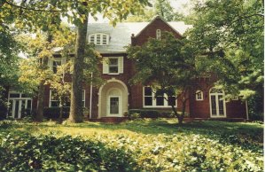
Setting
Place:
Atlanta, Georgia
Time:
Spans 25 years → 1948 - 1973

Slide 3
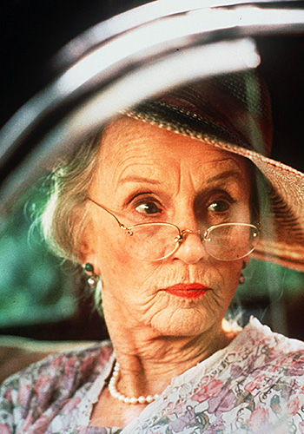
Characters
Daisy Werthan
Jewish widow
age spans 72-97
“feist”; “high energy”
former teacher
grew up poor
How did this influence her?

Slide 4
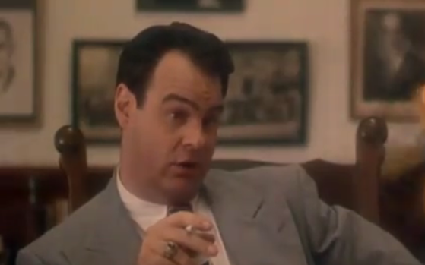
Characters
Boolie Werthan
Daisy’s son
age spans 40 – 65
$$$
“strong”; “capable”

Slide 5
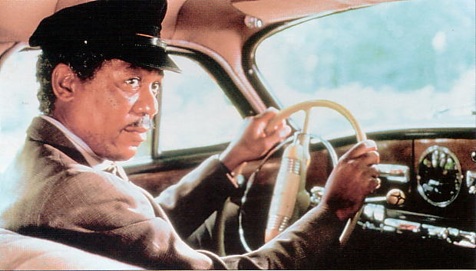
Characters
Hoke Coleburn
Daisy’s African American chauffeur
age spans 60 – 85
unemployed; uneducated
grateful to the Werthans

Slide 6
Theme: Finding Friendship in Unlikely Places
Daisy
Hoke

